Slide 1
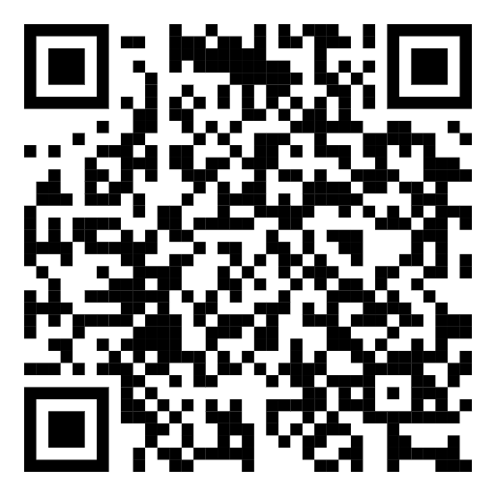
SI-PASS/PAL
ONLINE LEADER DEVELOPMENT ACTIVITIES
ACTIVITIES SPRING 2025:
LinkedIn group
For a unique chance to network with Leaders from across Europe, join our LinkedIn group by scanning this QR-code or by searching
“SI-PASS/PAL Leaders in Europe” on LinkedIn
26TH MARCH, 12-1PM GMT/1-2PM CET
Supercharge Revision and Exam Preparation –Getting ready for end-of-year sessions
Join SI-PASS supervisors Polly Harper and Han-Na Cha from the University of Birmingham who will guide us through discussions and idea-sharing for how to run engaging and collaborative SI-PASS sessions, focusing on revision and exam preparation.
Zoom-link: https://lu-se.zoom.us/j/64884723032
WHAT ARE THE ONLINE LEADER DEVELOPMENT ACTIVITIES?
FOCUS ON CONTINUING PROFESSIONAL DEVELOPMENT (CPD) FOR SI-PASS/PAL LEADERS
NETWORKING OPPORTUNITY
HOW DOES IT WORK?
FREE TO ATTEND FOR SI-PASS/PAL LEADERS
SIGN UP VIA THE QR CODE (encouraged but not required)
HOSTED ON ZOOM BY THE
EUROPEAN CENTER FOR SI-PASS/PAL

