Slide 1

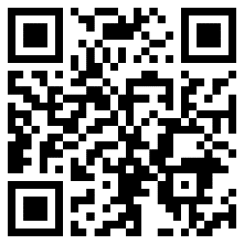

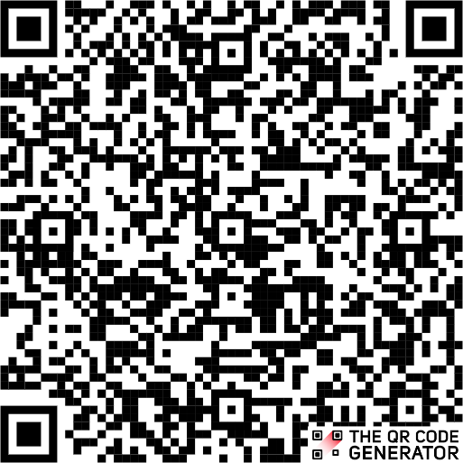

ACTIVITIES AUTUMN 2025:
LinkedIn group
For a unique chance to network with Leaders from across Europe, join our LinkedIn group by scanning this QR-code or by searching
“SI-PASS/PAL Leaders in Europe” on LinkedIn
7th OCTOBER, 12-1PM WEST/1-2PM CEST
THEME: TBA
FACILITATOR: TBA
Zoom-link:https://lu-se.zoom.us/j/61163340241
6th NOVEMBER, 12-1PM WET/1-2PM CET
THEME: Strategies for Facilitation
FACILITATOR: Polly Harper & Han-Na Cha, SI-PASS Supervisors at University of Birmingham
Zoom-link: https://lu-se.zoom.us/j/69054942831
3rd DECEMBER, 12-1PM WET/1-2PM CET
THEME: TBA
FACILITATOR: TBA
Zoom-link:https://lu-se.zoom.us/j/67267104854
SI-PASS/PAL
ONLINE LEADER DEVELOPMENT ACTIVITIES
WHAT ARE THE ONLINE LEADER DEVELOPMENT ACTIVITIES?
FOCUS ON CONTINUING PROFESSIONAL DEVELOPMENT (CPD) FOR SI-PASS/PAL LEADERS
NETWORKING OPPORTUNITY
HOW DOES IT WORK?
  FREE TO ATTEND FOR SI-PASS/PAL LEADERS
  SIGN UP VIA THE QR CODE (encouraged but not required)
  HOSTED ON ZOOM BY THE
EUROPEAN CENTER FOR SI-PASS

